Slide 1

MARKETING & RETAIL ANALYTICS Project
Name: Ihjaz Ahmed
Date: 02nd Feb 2023

Slide 2
Content
2
Exploratory Analysis and Inferences.
3
Use of Market Basket Analysis (Association Rules).
4
Associations Identified.
Suggestion of Possible Combos with Lucrative Offers.
5
Problem Statement.
1
Suggestion of Possible Combos with Lucrative Offers.
Suggestions to increase the business Sales

Slide 3
Problem Statement
Problem Statement:
The data set provided to you is the data set of a Café Chain for one of its restaurants. Do a thorough analysis of the data and come up with the following analysis. The owner of the restaurant wants you to use this data to come up with a set of recommendations that can help his Café Chain increase its revenues. He is able to provide you with a data set for POS (point of sale data) for one of his chains.
Exploratory Analysis of data & an executive summary (in PPT) of your top findings, supported by graphs. • What kind of trends do you notice in terms of consumer behavior over different times of the day and different days of the week? Can you give concrete recommendations based on the same? • Are there certain menu items that can be taken off the menu? • Are there trends across months that you are able to notice?
Menu Analysis- • Identify the most popular combos that can be suggested to the restaurant chain after a thorough analysis of the most commonly occurring sets of menu items in the customer orders. The restaurant doesn’t have any combo meals. Can you suggest the best combo meals? o Use of Market Basket Analysis (Association Rules) ▪ Write Something about the association rule and its relevance in this case ▪ Add KNIME workflow Image or Python package used ▪ Write about threshold values of Support and Confidence. Q. Associations Identified ▪ Put the associations in a tabular manner ▪ Explain about support, confidence, & lift values that are calculated. ▪ The suggestion of Possible Combos with Lucrative Offers ▪ Write recommendations ▪ Make discount offers or combos ( or buy two get one free) based on the associations and your experience.
Tools Used: Python ,Tableau & KNIME
Data Source: Café_Data_MRA.xlsx

Slide 4
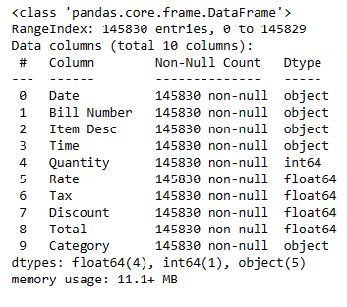
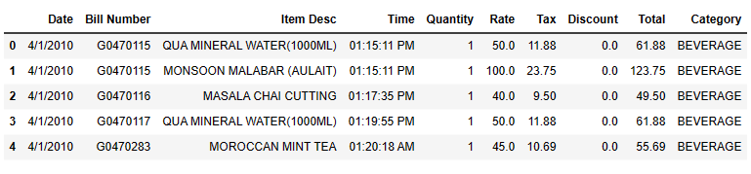
Exploratory Analysis and Inferences
About Data:
It contains 145830 transactions and 10 columns.
Data set has 5 object and 5 numeric columns.
There are no Null values in the dataset.
It contains details of sales of 580 items under 9 Product Categories from the year of 2010 to 2011.
There are 680 duplicate transactions which indicates customers had purchased of different brands of the Product Categories.

Slide 5
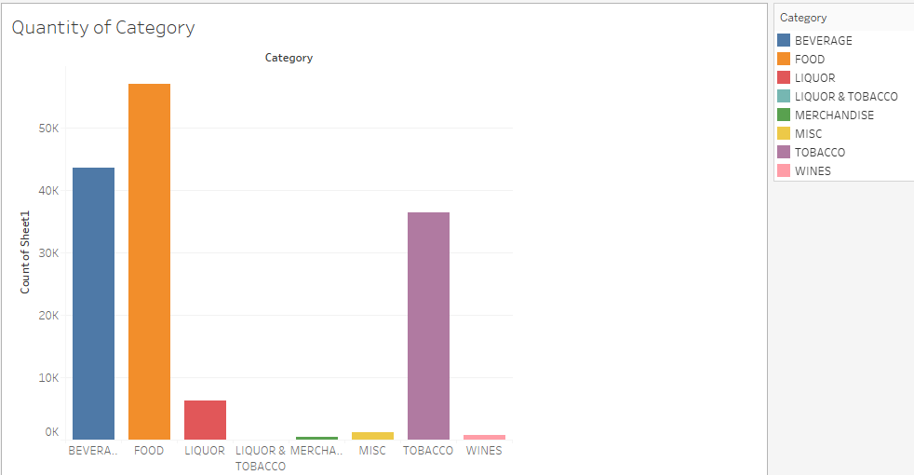
Exploratory Analysis and Inferences
Out of the orders, Food items was the most frequently ordered one (57,023) times, followed by beverages, tobacco and liquor.
Miscellaneous, wines, merchandise, liquor& tobacco are the least ordered.

Slide 6
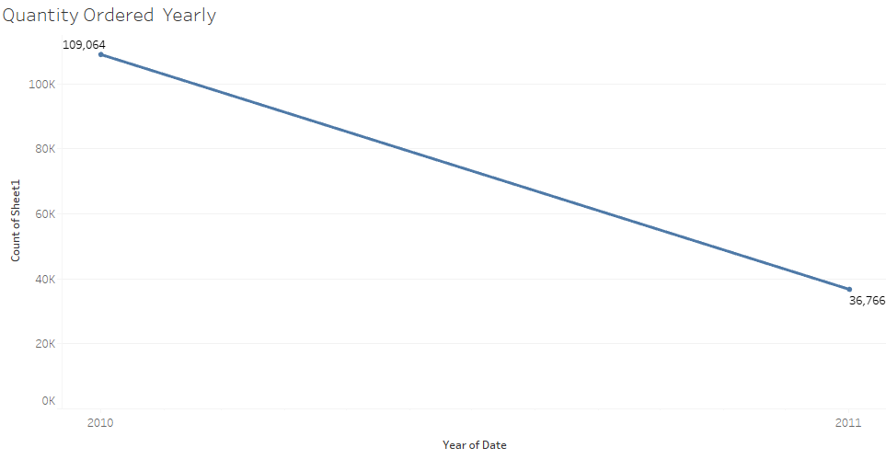
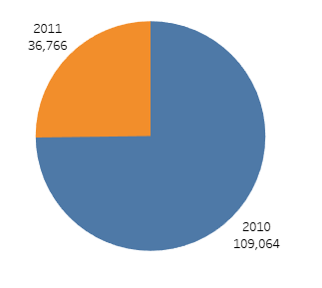
Exploratory Analysis and Inferences
The year 2010 has the most no of orders (109,064 Nos), and we can see a much decrease in the sales in the following year of 2011 (36,766).

Slide 7
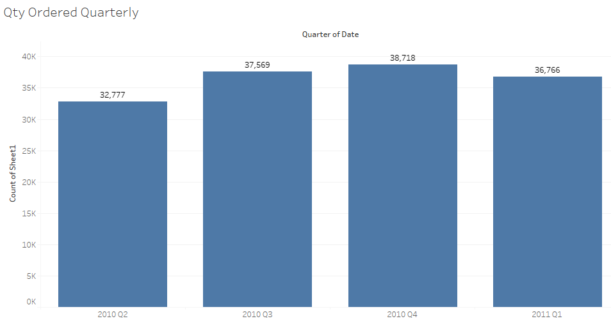
Exploratory Analysis and Inferences
Q4 of year 2010 has highest no of orders and Q2 of 2010 have least .
There is an increase trend in Quarterly orders till Q4 of year 2010 then it decreases in Q1 of 2011.

Slide 8
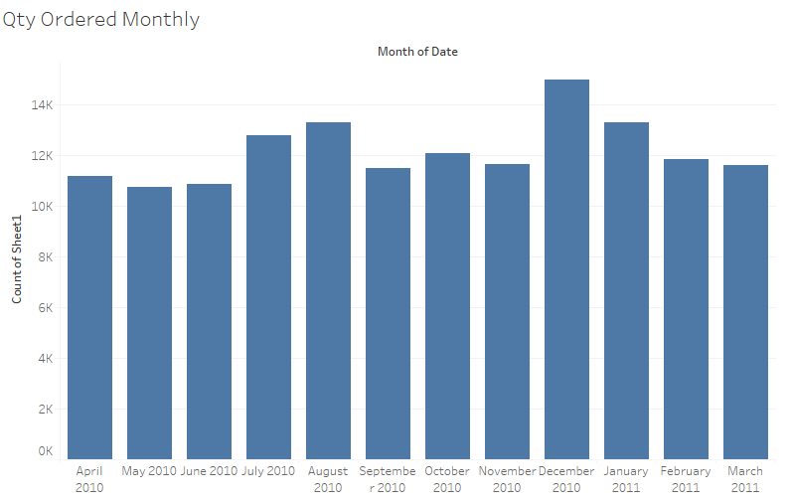
Exploratory Analysis and Inferences
December 2010 has highest no of orders however May 2010 has lowest no of orders.
There is a slight increase trend in orders from April 2010 to Dec 2010 and we can see that it starts to decline from Jan 2011.

Slide 9
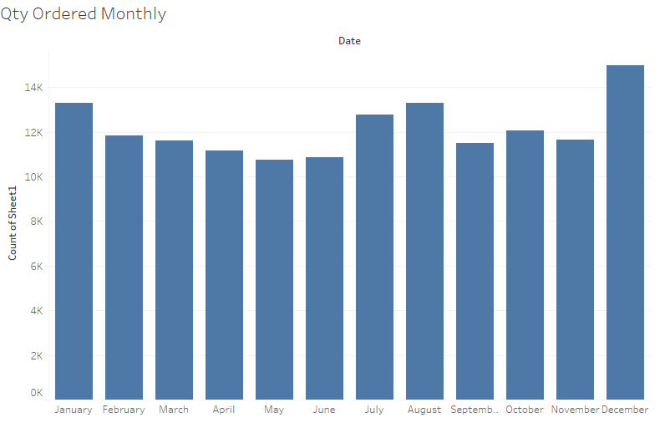
Exploratory Analysis and Inferences
December month has highest no of items ordered followed by August and January, May month has the lowest.

Slide 10
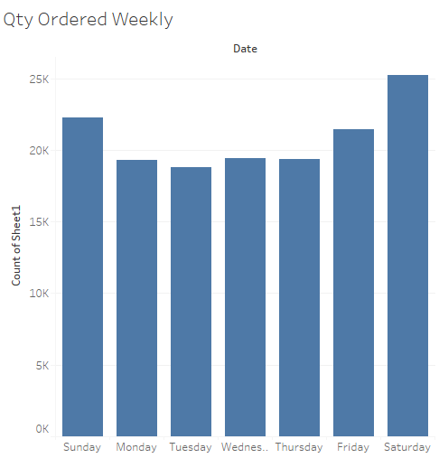
Exploratory Analysis and Inferences
In a Weekdays Saturday has highest followed by Sundays as they are holidays for most of the Customers and Tuesday has lowest.

Slide 11
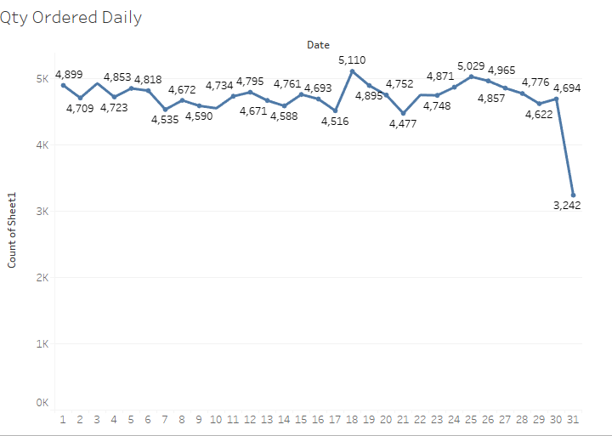
Exploratory Analysis and Inferences
Sales of the items keeps a constant trend then it peaks in the middle of the month and declines in the end of the month.

Slide 12
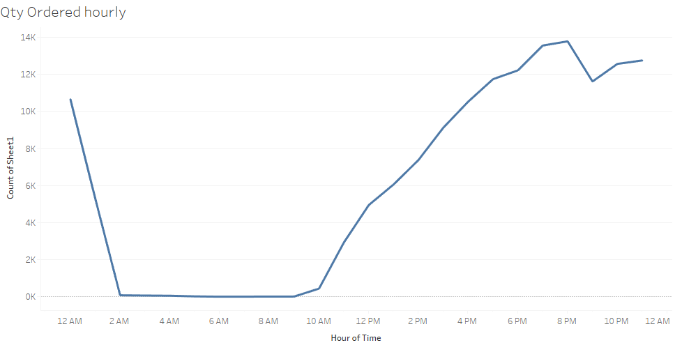
Exploratory Analysis and Inferences
In a day, Sales are mostly from 10 AM to 8 PM and then it declines at midnight.
6 PM to 8PM are the peak hours and 2 AM to 10 AM are the worst as it’s the sleeping hours.
Sales are ending at 2 AM.

Slide 13
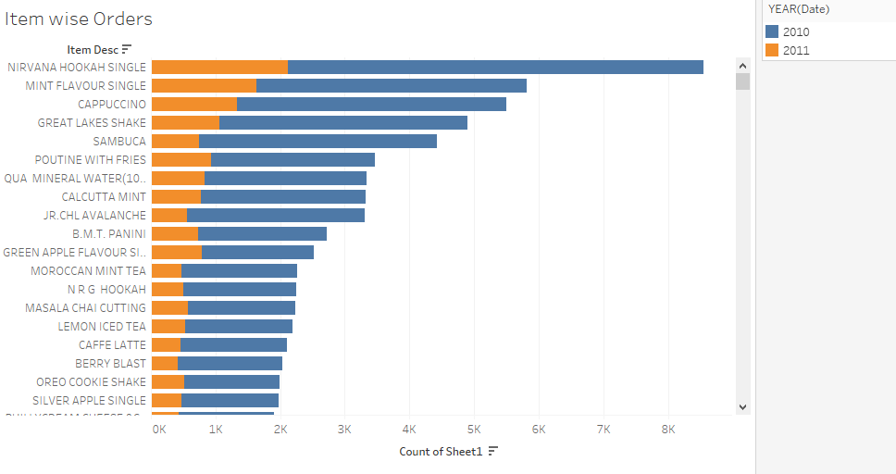
Exploratory Analysis and Inferences
Nirvana Hookah Single has the highest sales in the year of 2010 followed by Mint Flavor Single and Cappuccino.

Slide 14
Exploratory Analysis and Inferences
SUMMARY
Out of the orders, Food items was the most frequently ordered one (57,023) times, followed by beverages, tobacco and liquor. Miscellaneous, wines, merchandise, liquor& tobacco are the least ordered.
The year 2010 has the most no of orders (109,064 Nos), and we can see a much decrease in the sales in the following year of 2011 (36,766).
There is an increase trend in Quarterly orders till Q4 of year 2010 then it decreases in Q1 of 2011.
There is a slight increase trend in orders from April 2010 to Dec 2010 and we can see that it starts to decline from Jan 2011.
December month has highest no of items ordered followed by August and January, May month has the lowest.
In a Weekdays Saturday has highest and Tuesday has lowest.
Sales of the items keeps a constant trend then it peaks in the middle of the month and declines in the end of the month.
In a day, Sales are mostly from 10 AM to 8 PM and then it declines at midnight. 6 PM to 8PM are the peak hours and 2 AM to 10 AM are the worst as it’s the sleeping hours.
Nirvana Hookah Single has the highest sales in the year of 2010 followed by Mint Flavor Single and Cappuccino.
Tableau link for the analysis
MRA Project | Tableau Public

Slide 15
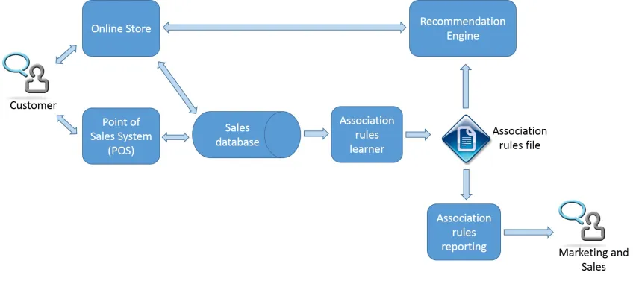
Use of Market Basket Analysis (Association Rules)
Market Basket Analysis:
Market basket analysis is a data mining technique used by retailers to increase sales by better understanding customer purchasing patterns. It involves analyzing large data sets, such as purchase history, to reveal product groupings, as well as products that are likely to be purchased together.
Association Rules:
Association rule mining is a procedure which aims to observe frequently occurring patterns, correlations, or associations from dataset /database. It is used to identify unique patterns and rules. Those patterns define relationships and interactions between different items.
There are 3 key metrics to consider when evaluating association rules:
Support: Percentage of transactions that contain the item set.
Support = Freq(X,Y)/N

Slide 16
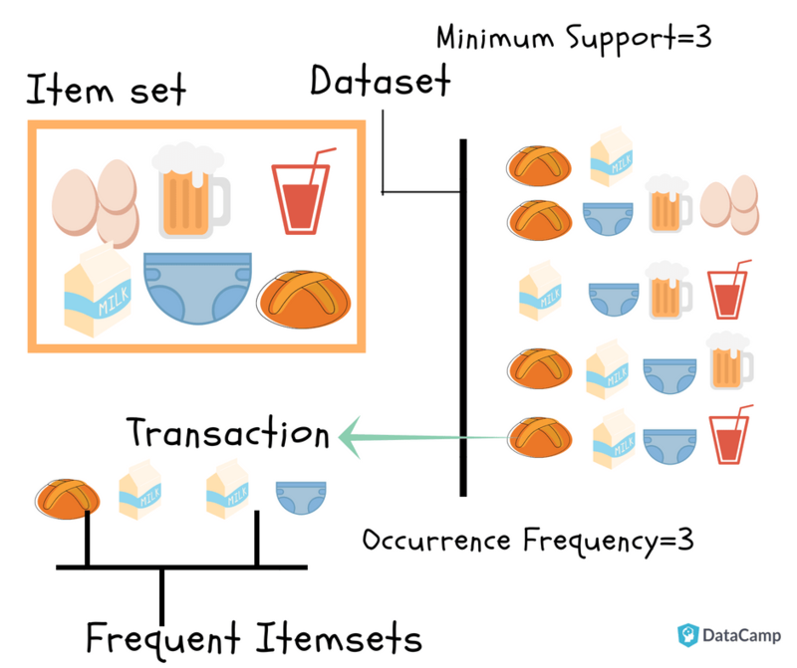
Use of Market Basket Analysis (Association Rules)
Confidence:
Given two items, X and Y, confidence measures the percentage of times that item Y is purchased, given that item X was purchased. This is expressed as:.
Confidence = Freq(X,Y)/Freq(X)
Confidence values range from 0 to 1, where 0 indicates that Y is never purchased when X is purchased, and 1 indicates that Y is always purchased whenever X is purchased. Note that the confidence measure is directional.
Lift:
Unlike the confidence metric whose value may vary depending on direction (e.g.: confidence{X ->Y} may be different from confidence{Y ->X}), lift has no direction. This means that the lift{X,Y} is always equal to the lift{Y,X}:.
This is expressed as:.
lift{X,Y} = lift{Y,X} = support{X,Y} / (support{X} * support{Y})
In summary, lift can take the following values:
Lift = 1; implies no relationship between X and Y (i.e., X and Y occur together only by chance)
Lift > 1; implies that there is a positive relationship between X and Y (i.e., X and Y occur together more often than random)
Lift < 1; implies that there is a negative relationship between X and Y (i.e., X and Y occur together less often than random)

Slide 17
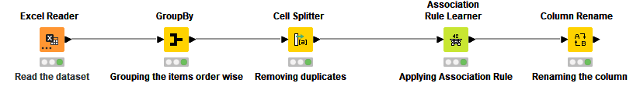
Use of Market Basket Analysis (Association Rules)
KNIME Workflow Image
Here I will apply Association rule with certain level of support and confidence threshold so that i can generate rules which can help me to club product in such way that business can make use of it and sale more products to customers.
Below are the threshold values used in association rules calculation
- Threshold values of Support is 0.002
- Threshold values of Confidence is 0.08
Association Rules must satisfy both a minimum support threshold and a minimum confidence threshold.

Slide 18
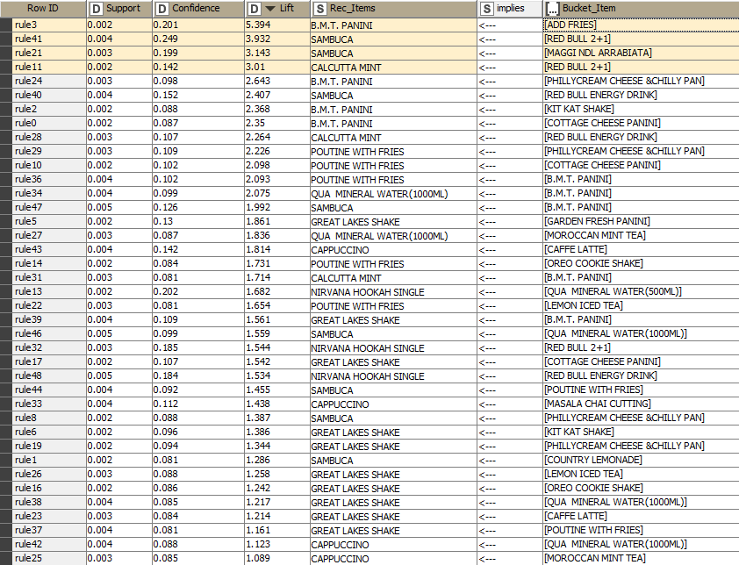
Identified Associations
Association Table
This is the most part of our Market Basket Analysis.
We have here the three metrics that are Support, Confidence and Lift arranged in descending order of lift value.
Below are the parameters used for calculation of associations –
Support Of Minimum - 0.002
Maximum item set Length – 10
Minimum Confidence Level - 0.08

Slide 19
Identified Associations
support, confidence, & lift values for Association
Rule 3 has support of 0.002 means approx. 0.2% Fraction of transactions containing the food item Add Fries has a confidence of 0.201 means Probability of occurrence of food item BMT Panini in the basket given Add Fries is present is 20.1% and lift of 5.394, lift ratios higher than 1 indicate strong association between items.
Rule 41 has support of 0.004 means approx. 0.4% Fraction of transactions containing the beverage item Red bull (2+1) Combo , confidence of 0.249 means Probability of occurrence of Sambuca tobacco given Red bull (2+1) Combo is present is 24.9% and lift of 3.932, lift ratios higher than 1 indicate strong association between items.
Rule 21 has support of 0.003 means approx. 0.3% Fraction of transactions containing the Maggi NDL Arrabiata, confidence of 0.199 means Probability of occurrence of Sambuca tobacco given Maggi NDL Arrabiata is present is 19.9% and lift of 3.143, lift ratios higher than 1 indicate strong association between items.
Rule 11 has support of 0.002 means approx. 0.2% Fraction of transactions containing the beverage item Red bull (2+1) Combo , confidence of 0.142 means Probability of occurrence of Calcutta Mint tobacco given Red bull (2+1) Combo is present is 14.2% and lift of 3.01, lift ratios higher than 1 indicate strong association between items.

Slide 20
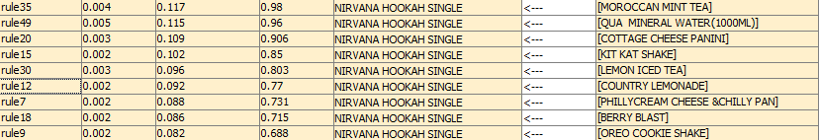
Identified Associations
Menus to be taken off:
As the probability of Occurrence of Nirvana Hookah tobacco given other food or beverage items is very low and should be taken off the Menu.

Slide 21
Suggestion of Possible Combos with Lucrative Offers
Possible Combos
Combo 1 – Add Fries and B.M.T Panini.
Combo 2 – Red Bull (2+1) Combo and Sambuca tobacco.
Combo 3 – Maggi NDL Arrabiata and Sambuca tobacco .
Combo 4 – Red Bull (2+1) Combo and Calcutta Mint tobacco .
Combo 5 – Philly Cream Cheese & Chilly Pan and Pountine with Fries.
- Cafe can run Combo offers on above combos with discounted prices if bought together.
- Cafe can also run offer life for Red Bull(2+1) & Maggi NDL Arrabaita with discounted prices if Sambuca tobacco is bought.
Or 30% off for Poutine with Fries if Philly Cream Cheese & Chilly Pan is purchased.
Best offers or free Red Bull(2+1) can be given if Calcutta Mint tobacco is purchased.

Slide 22
Suggestions to increase the business Sales
Below steps needs to be taken by the business for better sale
Host a grant opening event to increase the sales with free entry and ask attendees to register online.
Establish and optimize a Social Media presence using most relevant media platforms and Media Influencers.
Optimize your Google My Business Listing by adding photos, menu links, tags to your listing to make easy for guests to discover online.
Run digital Ads and Traditional Ads via Social Medias to increase the Sales.
Send Guests targeted Offers like messaging them like “We Miss You” to invite guests.
Best Combo Offers can be given to increase the online ordering.
Implement a Loyalty Program that lets customers accumulate points for on-site and online orders to increase the revenue.
Offer prix fixe menu with multiple courses to encourage Customers to spend more.
Make personalized recommendations to increase the profits.
Sell Merchandise featuring the Café’s branding.

Slide 23


